Slide 1
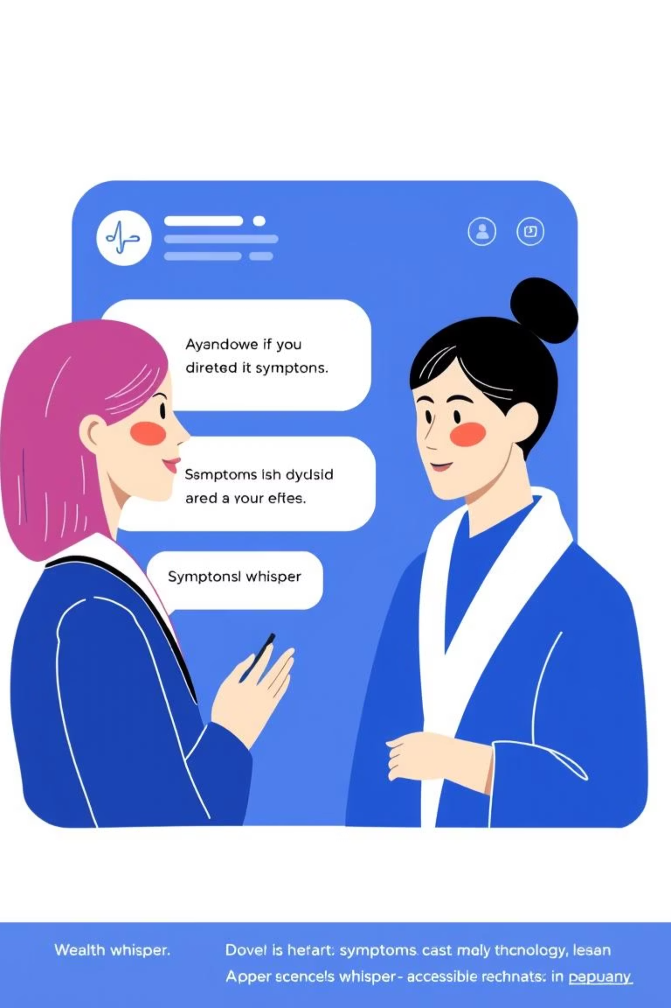
AI-Enabled Virtual Health Assistant for Refugees
Empowering vulnerable communities with immediate health guidance and access to vital services.

Slide 2
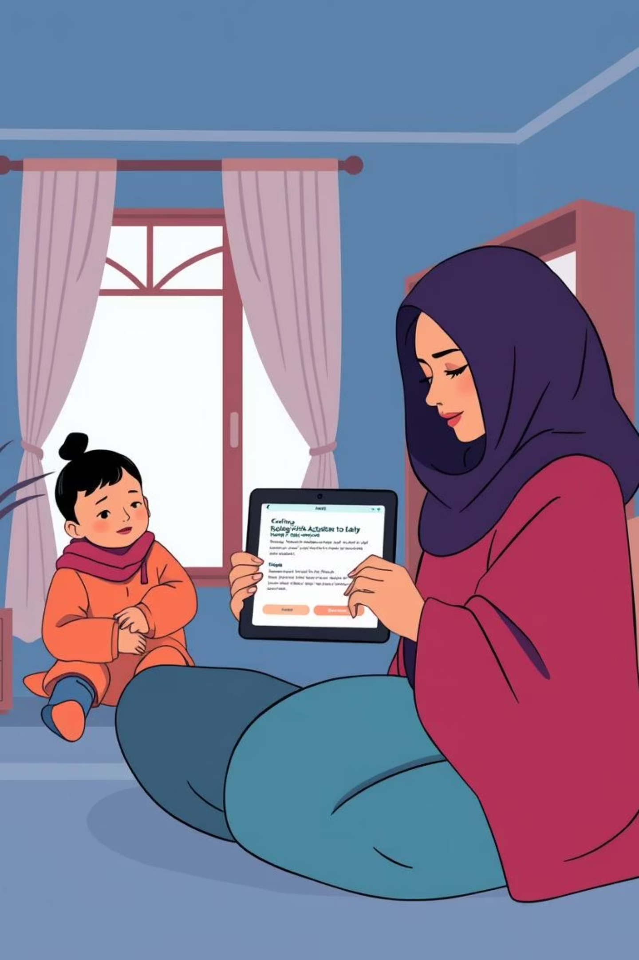
Team Codeflakes | Healthcare Track
Addressing the Challenge
Refugees often face significant barriers to accessing healthcare, including language difficulties, lack of information, and limited resources. Our solution, the AI-Enabled Virtual Health Assistant, bridges this gap by providing immediate, preliminary medical guidance and connecting users to essential services.

Slide 3




Core Functionalities & Benefits
AI-Enabled Symptom Triage
Connects to Health Services
Provides immediate, preliminary medical guidance based on user-entered symptoms, helping users understand their condition and next steps.
Allows users to find and connect with nearby humanitarian health services, addressing the barrier of access to care.
Scalable and Accessible
Aligned with SDGs
The web-based platform is designed to be lightweight and accessible on any device with a browser, removing the need for specialized applications or hardware.
The project aligns with UN Sustainable Development Goals 3 (Good Health and Well-being), 10 (Reduced Inequalities), and 16 (Peace, Justice and Strong Institutions).

Slide 4
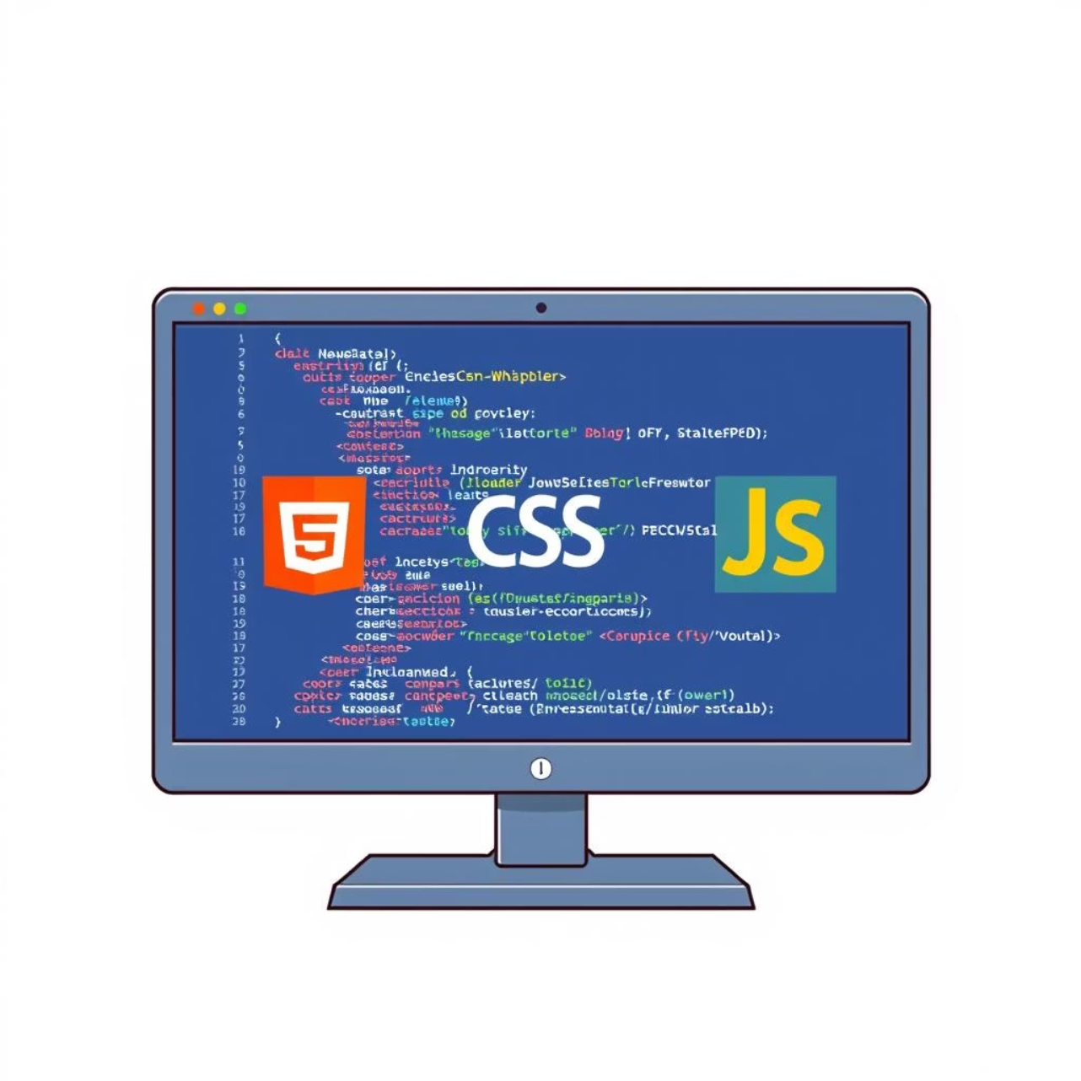
Our Tech Stack: Simplicity & Speed
Our prototype is built using fundamental web technologies: HTML, CSS, and JavaScript. This approach prioritizes:
Simplicity & Speed: A front-end-only tech stack is lightweight and loads quickly, crucial for users with limited connectivity.
Cross-Platform Compatibility: Runs in any modern web browser without the need for installation, ensuring broad accessibility.
Ease of Development: Leveraging common web languages allows for rapid prototyping and agile development.

Slide 5

The User Journey: How It Works
User Input
Form Submit
Symptom Analysis
AI Logic

Slide 6
Scaling for Broader Impact
While the current prototype is a functional front-end application, future development will focus on robust scalability:
Advanced AI Integration
Real-time Service Connectivity
Multi-Language Support
Implement a robust back-end server with a machine learning model for more sophisticated symptom analysis and accurate diagnoses.
Integrate with real-time humanitarian services databases or mapping APIs for accurate, up-to-date location services.
Expand accessibility by incorporating multi-language support to cater to a wider range of refugee communities.

Slide 7
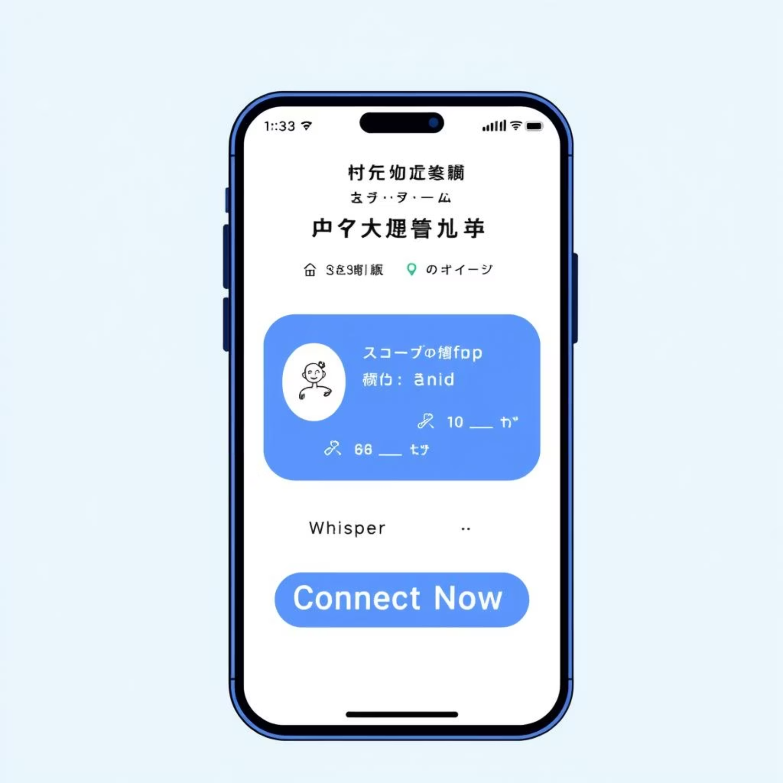
Intuitive & User-Friendly Interface
The interface is designed for clarity and ease of use, ensuring a seamless experience even for users unfamiliar with digital tools. It features two primary sections:
Check Your Symptoms: A simple input box and a submit button allow users to quickly describe their health concerns.
Need Help?: A prominent "Connect Now" button immediately directs users to nearby health services, addressing urgent needs.

Slide 8


Conclusion: A Lifeline in Every Pocket
The AI-Enabled Virtual Health Assistant offers a crucial first step in medical guidance for refugees. By leveraging simple web technologies, it provides a quick, accessible, and essential tool for symptom triage and connecting to humanitarian health services.
This project has the potential to significantly improve health outcomes and reduce inequalities in vulnerable communities, embodying the spirit of global solidarity and innovation.

